Slide 1

Tetris System on Gameboy
By Matthias Seys

Slide 2

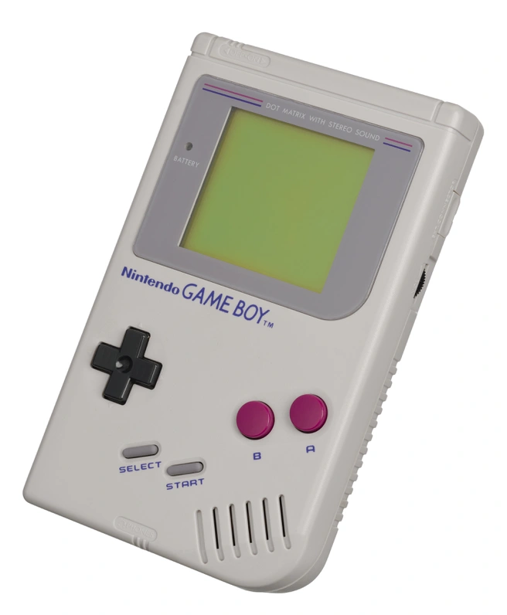
Abstract
What you see is what you get.
Screen and Buttons only.
System playing Tetris.
Best Tetris move algorithm.

Slide 3

Research
Gameboy Emulator
Tetris
System
Algorithm

Slide 4
Research
Gameboy Emulator
Screen
Buttons
Bugs?
Tetris
System
Algorithm

Slide 5

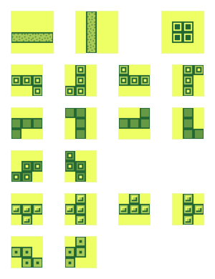
Research
Gameboy Emulator
Tetris
Rules
Piece Rotations
System
Algorithm

Slide 6
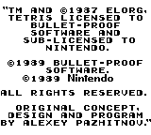
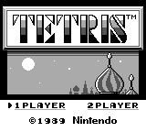
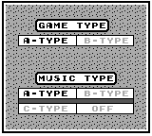
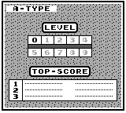
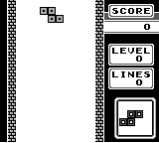
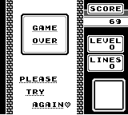
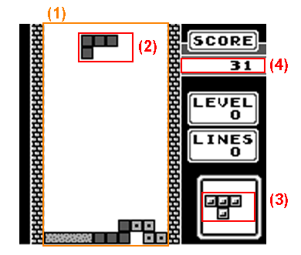
Research
Gameboy Emulator
Tetris
System
Screens
What is useful data?
How can I get it?
Algorithm

Slide 7
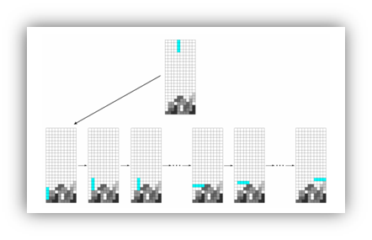
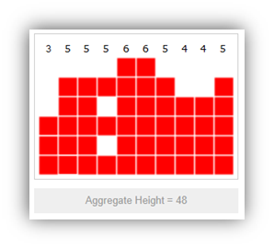
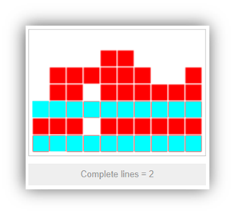
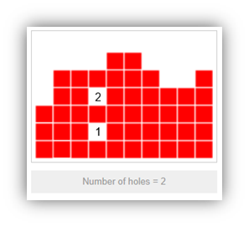
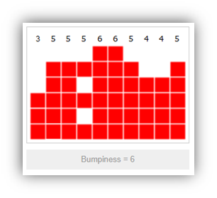
Research
Gameboy Emulator
Tetris
System
Algorithm
Depth-first or breadth-first?
How deep can we go?
What can we use to define a good move?

Slide 8
Research Conclusion
Noticeable bugs in Gameboy emulator.
System was more planning, less research.
System needed to work around of emulator bugs.
Algorithm was the most research.

Slide 9
Case Study
System
Get Pixel(s)
Playfield, Current Piece, Next Piece & Score
Screens
Algorithm
Move prediction
Best Move prediction
Bugs!

Slide 10
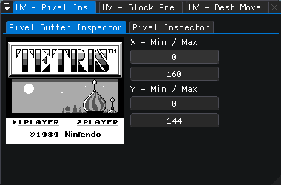
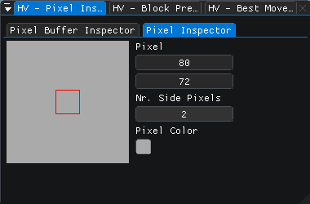
Case Study
System
Get Pixel(s)
Playfield, Current Piece, Next Piece & Score
Screens
Algorithm
Move prediction
Best Move prediction
Bugs!

Slide 11
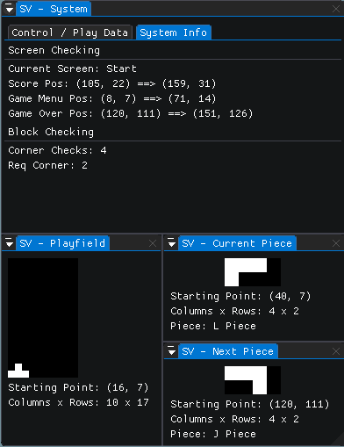
Case Study
System
Get Pixel(s)
Playfield, Current Piece, Next Piece & Score
Screens
Algorithm
Move prediction
Best Move prediction
Bugs!

Slide 12
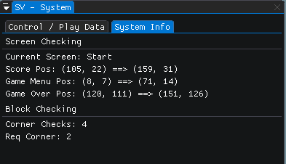
Case Study
System
Get Pixel(s)
Playfield, Current Piece, Next Piece & Score
Screens
Algorithm
Move prediction
Best Move prediction
Bugs!

Slide 13
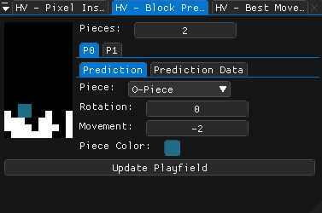
Case Study
System
Get Pixel(s)
Playfield, Current Piece, Next Piece & Score
Screens
Algorithm
Move prediction
Best Move prediction
Bugs!

Slide 14
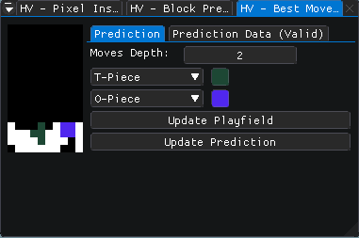
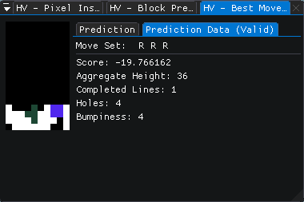
Case Study
System
Get Pixel(s)
Playfield, Current Piece, Next Piece & Score
Screens
Algorithm
Move prediction
Best Move prediction
Bugs!

Slide 15
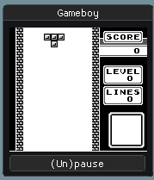
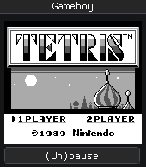
Case Study
System
Get Pixel(s)
Playfield, Current Piece, Next Piece & Score
Screens
Algorithm
Move prediction
Best Move prediction
Bugs!
Depth only happened on last possible move.
System ran faster than Gameboy (keys get skipped)
Move backtrack had flaws. (to get back to first move)

Slide 16

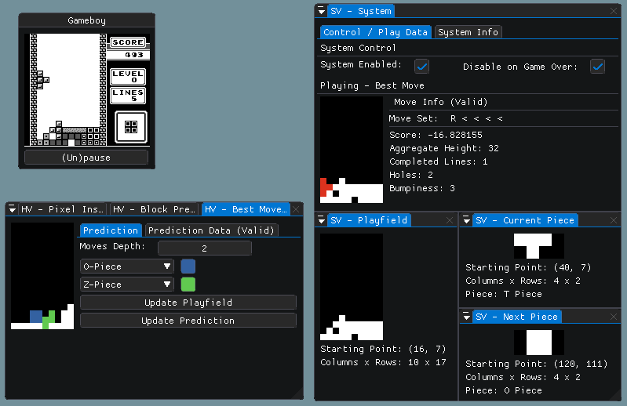
Conclusion
Fun experiment.
Not something others have done before.
Sometimes hard finding a solution.

Slide 17
Looking back…
Create helper views (debug visually).
Rewrite code now and then.
Take weekend breaks to clear your mind.
Don’t work long evenings, it doesn’t help.

Slide 18
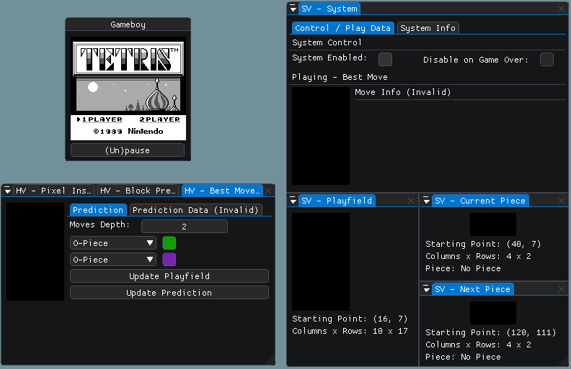
Demo

Slide 19

Any further questions?
Be sure to check out the paper which contains more details on the entire process.

